Slide 1
Networking Ports
Matheus Rodrigues Santos

Slide 2
Quick review last session
What Are Cookies?
Cookies are text files with small pieces of data — like a username and password — that are used to identify your computer as you use a computer network. Specific cookies known as HTTP cookies are used to identify specific users and improve your web browsing experience.
Data stored in a cookie is created by the server upon your connection. This data is labeled with an ID unique to you and your computer.
When the cookie is exchanged between your computer and the network server, the server reads the ID and knows what information to specifically serve to you.

Slide 3
What is Angular?
Angular is a platform and framework for building single-page client applications using HTML and TypeScript. Angular is written in TypeScript. It implements core and optional functionality as a set of TypeScript libraries that you import into your applications.

Slide 4
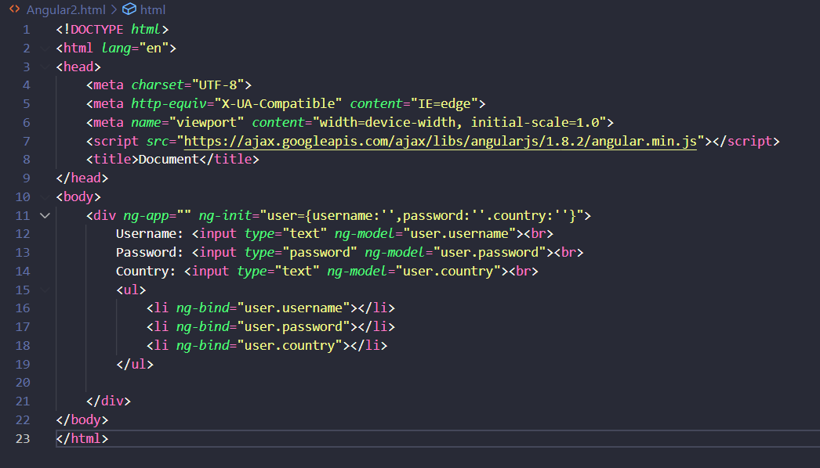

Slide 5
Question 1: What is a cookie from internt?
A) A delicious cookie with chocolate chips
B)are text files with small pieces of data — like a username used just for user name
C)are text files with small pieces of data — like a username and password
D)Come Back to 2 slide.

Slide 6
Question 2: wich comand Is the starting point of AngularJS Application?
A)ng-bind
B)ng-app
C)ng-init
D)ng-model
E)I Dont Know

Slide 7
What is a port?
A port is a virtual point where network connections start and end. Ports are software-based and managed by a computer's operating system. Each port is associated with a specific process or service. Ports allow computers to easily differentiate between different kinds of traffic: emails go to a different port than webpages, for instance, even though both reach a computer over the same Internet connection.

Slide 8
What is a port number?
Ports are standardized across all network-connected devices, with each port assigned a number. Most ports are reserved for certain protocols — for example, all Hypertext Transfer Protocol (HTTP) messages go to port 80. While IP addresses enable messages to go to and from specific devices, port numbers allow targeting of specific services or applications within those devices.

Slide 9
How do ports make network connections more efficient?
Vastly different types of data flow to and from a computer over the same network connection. The use of ports helps computers understand what to do with the data they receive.

Slide 10
Are ports part of the network layer?
Ports are a transport layer (layer 4) concept. Only a transport protocol such as the Transmission Control Protocol (TCP) or User Datagram Protocol (UDP) can indicate which port a packet should go to.

Slide 11
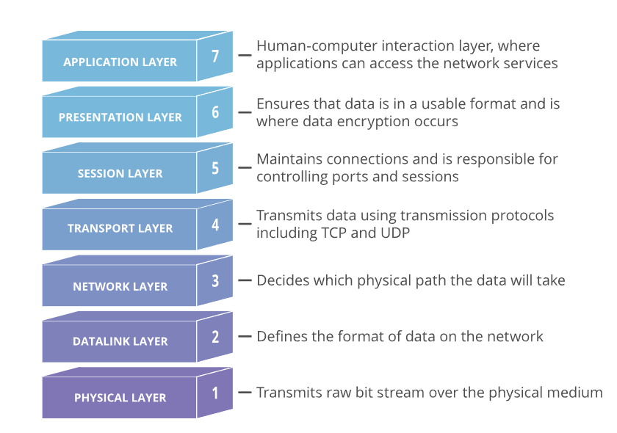

Slide 12
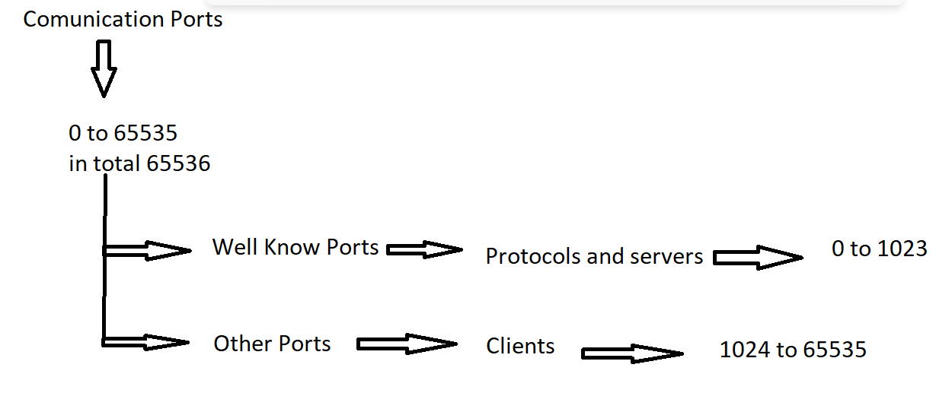

Slide 13
What are the different port numbers?
Ports 20 and 21: File Transfer Protocol (FTP). FTP is for transferring files between a client and a server.
Port 22: Secure Shell (SSH). SSH is one of many tunneling protocols that create secure network connections.
Port 25: Simple Mail Transfer Protocol (SMTP). SMTP is used for email.
Port 53: Domain Name System (DNS). DNS is an essential process for the modern Internet; it matches human-readable domain names to machine-readable IP addresses, enabling users to load websites and applications without memorizing a long list of IP addresses.
Port 80: Hypertext Transfer Protocol (HTTP). HTTP is the protocol that makes the World Wide Web possible.

Slide 14
Port 123: Network Time Protocol (NTP). NTP allows computer clocks to sync with each other, a process that is essential for encryption.
Port 179: Border Gateway Protocol (BGP). BGP is essential for establishing efficient routes between the large networks that make up the Internet (these large networks are called autonomous systems). Autonomous systems use BGP to broadcast which IP addresses they control.
Port 443: HTTP Secure (HTTPS). HTTPS is the secure and encrypted version of HTTP. All HTTPS web traffic goes to port 443. Network services that use HTTPS for encryption, such as DNS over HTTPS, also connect at this port.

Slide 15
Port 500: Internet Security Association and Key Management Protocol (ISAKMP), which is part of the process of setting up secure IPsec connections.
Port 3389: Remote Desktop Protocol (RDP). RDP enables users to remotely connect to their desktop computers from another device.

Slide 16
Question 3: What is A FTP?
A)File Transfer Protocol
B)File Tranport Protocol
C)File Transfer Project
D)First Topic Presented
E)I dont know.

Slide 17
Question 4: in total how many comunication ports exist?
A)65535
B)65435
C)6000
D)65536
E)come back to slide 12

Slide 18
Thank you!!
As we finish if you have intersted:
Type netstat on your cmd to see wich ports are open in your local system.

Slide 19
References
https://angular.io/
https://www.tutorialsteacher.com/angularjs/angularjs-ng-app-directive#:~:text=The%20ng%2Dapp%20directive%20is,and%20compiles%20the%20HTML%20template.
https://www.kaspersky.com/resource-center/definitions/cookies
https://www.cloudflare.com/learning/network-layer/what-is-a-computer-port/
https://www.youtube.com/watch?v=DJ6e6HoJ5kI Brazilian youtube Chanel

